Slide 1
Cartoons
CCS1210
Introduction to Web Technologies
Team: Arbnor Rama, Ylber Galica, Edon Ramadani, Gent Osmani, Anduena Halimi

Slide 2
Outline
Home Page
History
Styles
Studios
Principles

Slide 3
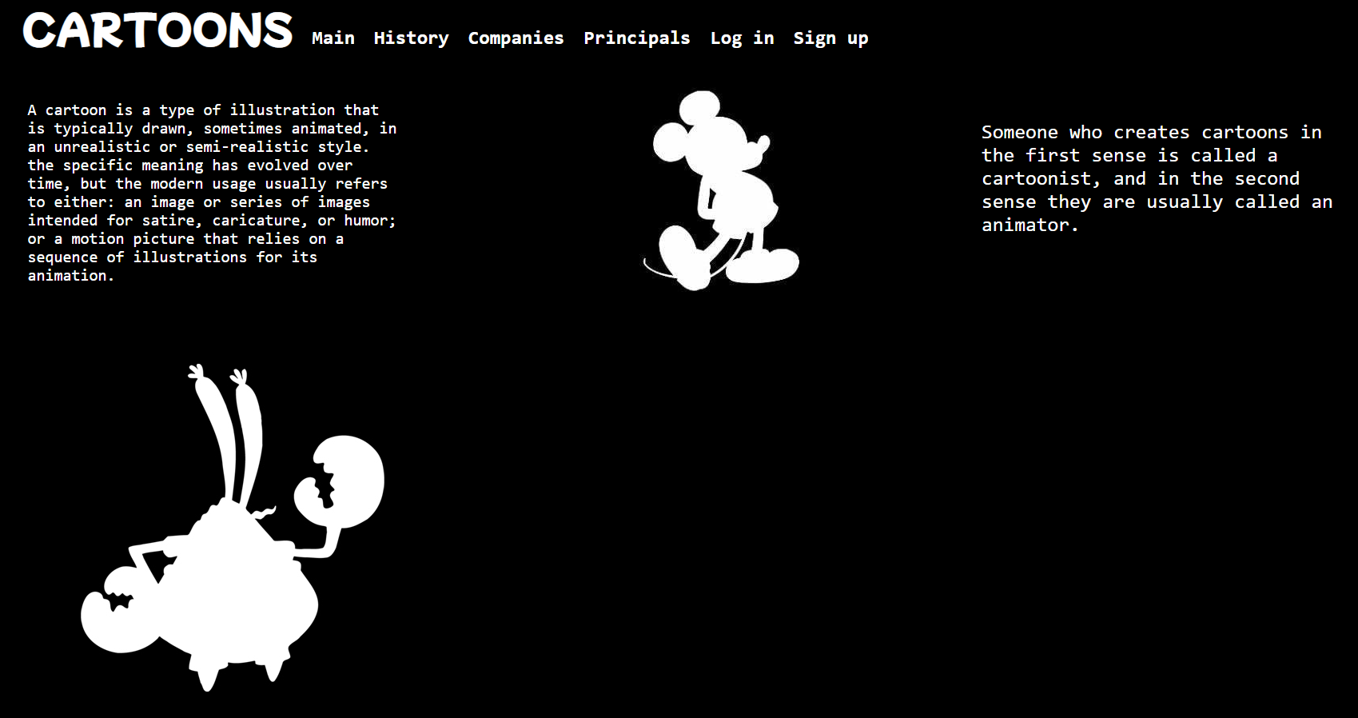
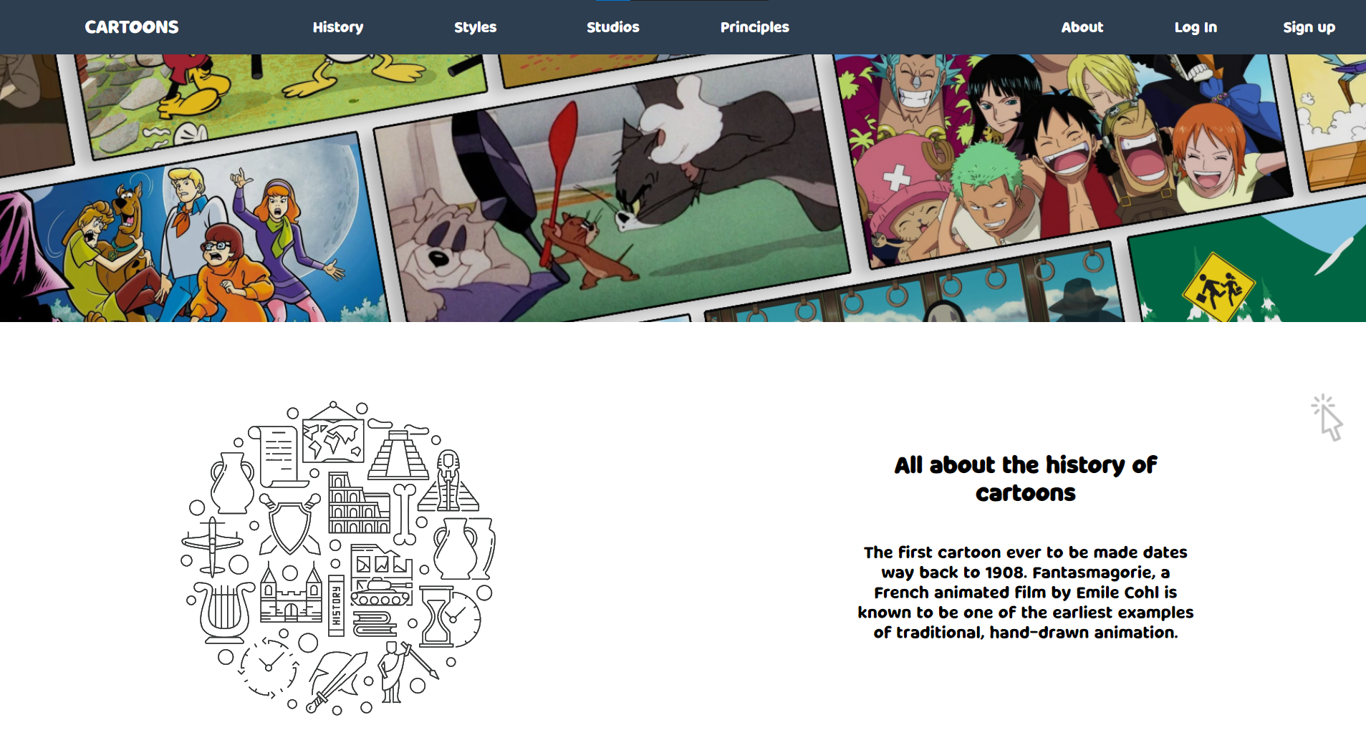
Home Page

Slide 4
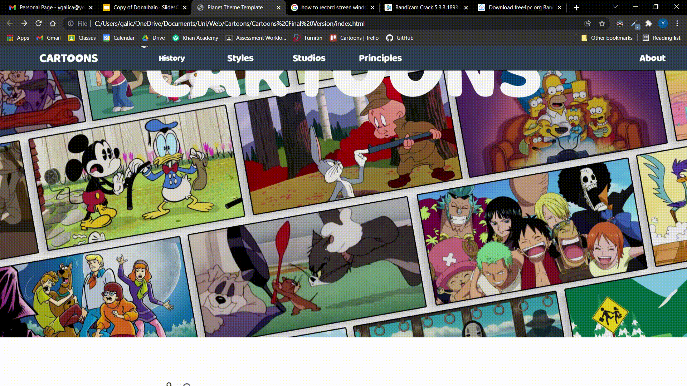
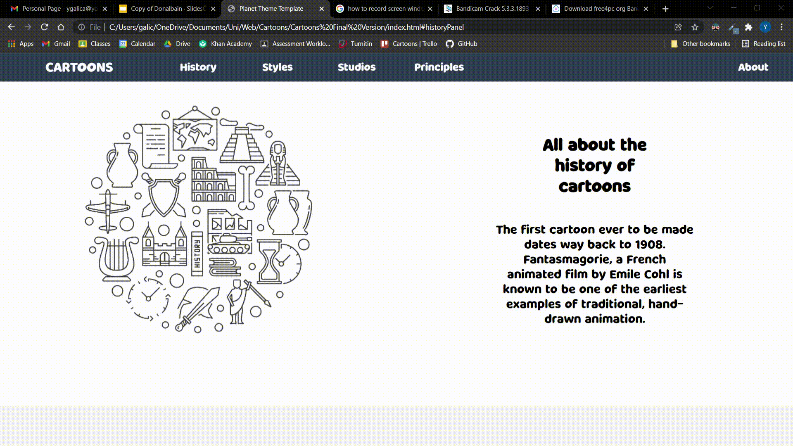
Navigation Bar

Slide 5
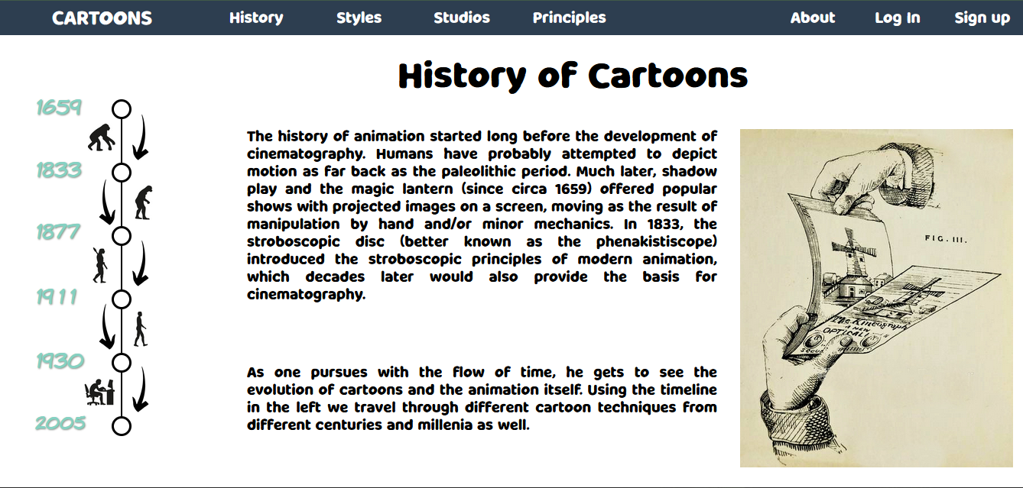
History Pages
The first page is simple
Hardly any details

Slide 6
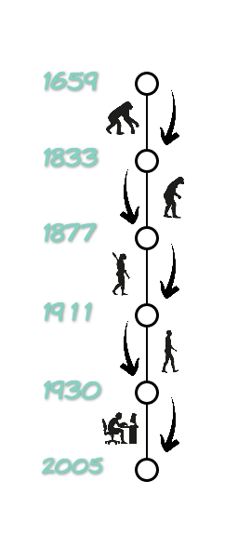
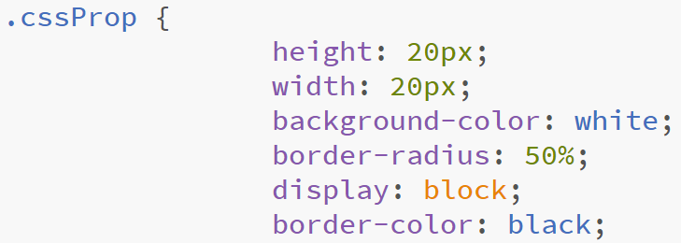
Timeline Sidebar
Everything is based on it.
The dots and the line are divs.
Decorated with different images.

Slide 7
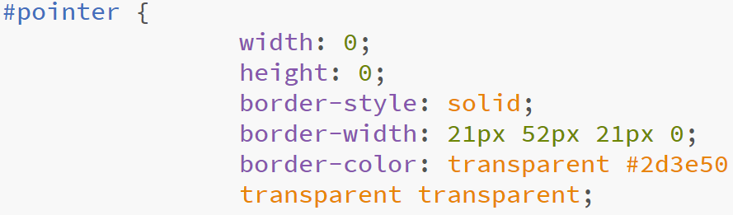
The slideshow
Clicking on a circle hides the content and opens an iframe.
All the pages are displayed there.
Different circle opens different web page.
Another div also shows, which indicates which webpage is opened.

Slide 8
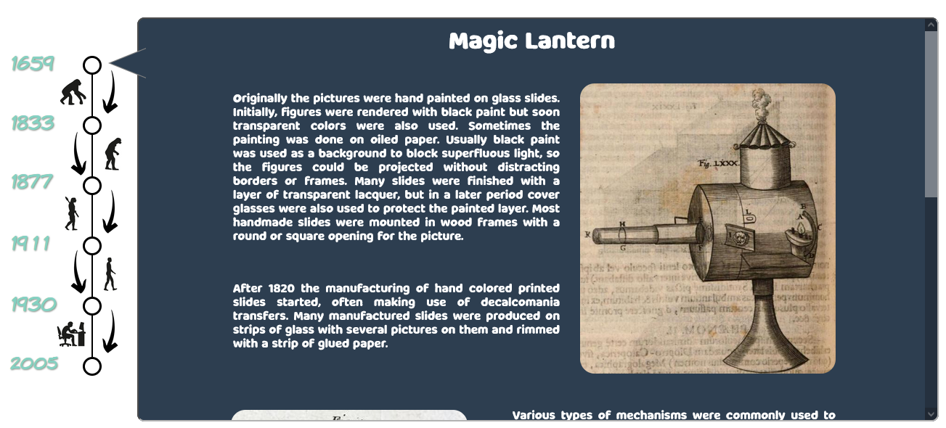

Slide 9
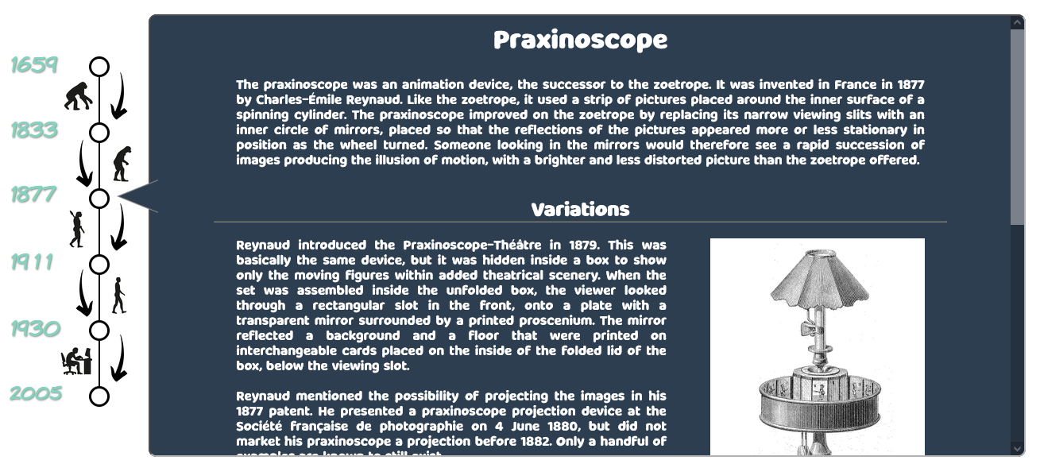
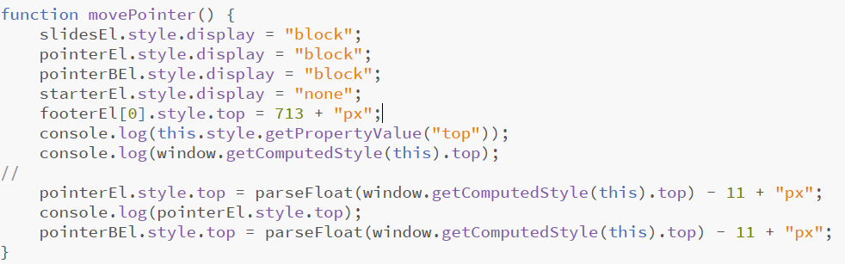

Slide 10
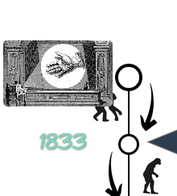
Display none + Transition
Hovering on specific circles shows some GIFs
By mistake, they were clickable
Changing the display property removed the transition
Used javascript to set a delay

Slide 11
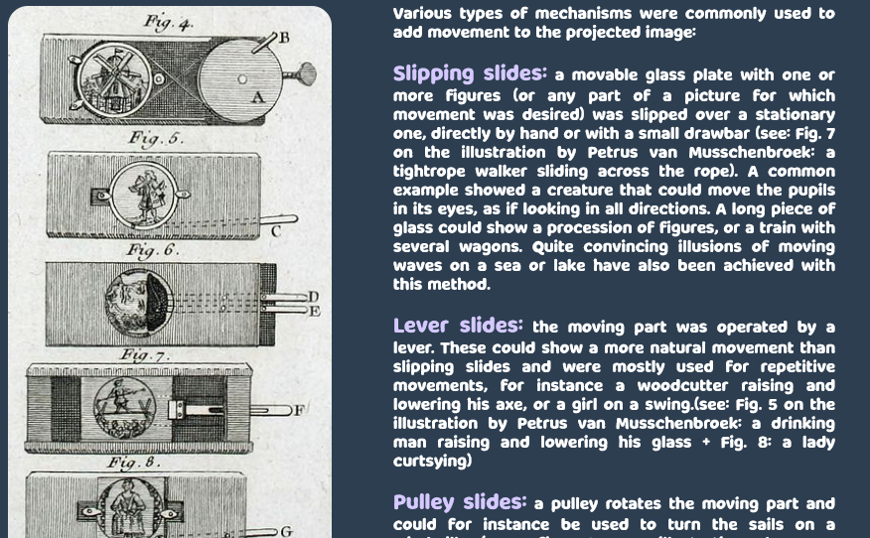
Span- the best tag on HTML

Slide 12
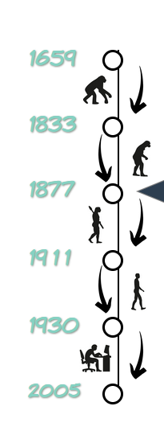
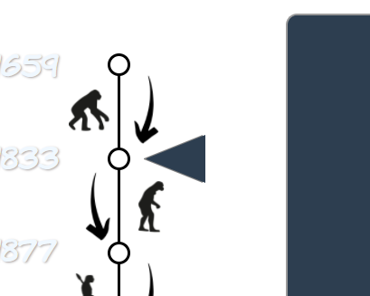
Failed Attempts

Slide 13
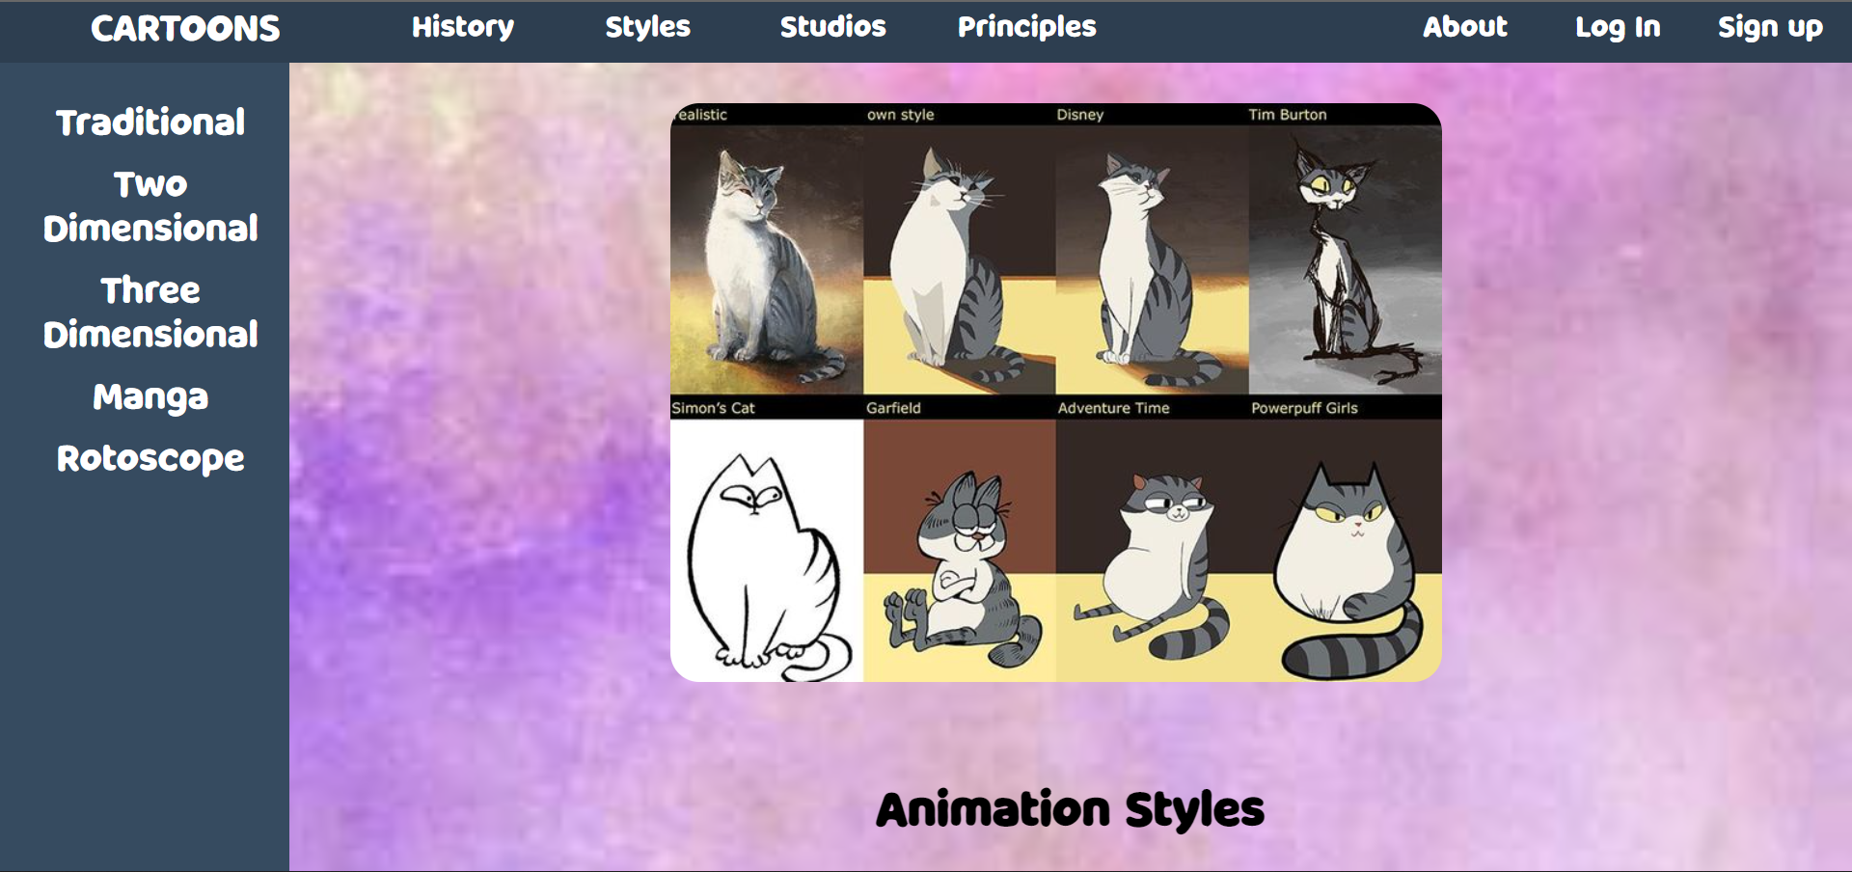
STYLE PAGES

Slide 14
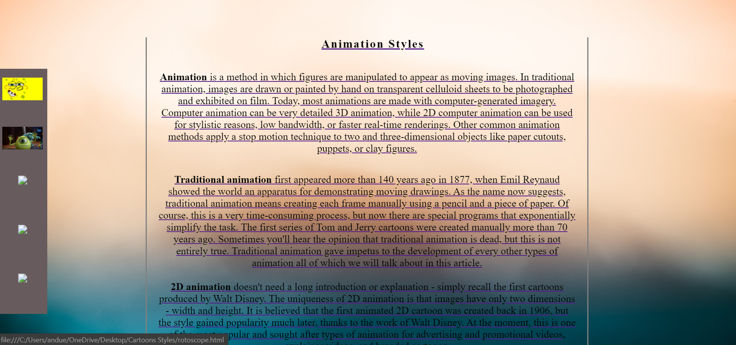
The first attempt:

Slide 15
Style Tree
CARTOONS
ANIMATION STYLES
TRADITIONAL
2DIMENSIONAL
3DIMENSIONAL
MANGA
ROTOSCOPE

Slide 16
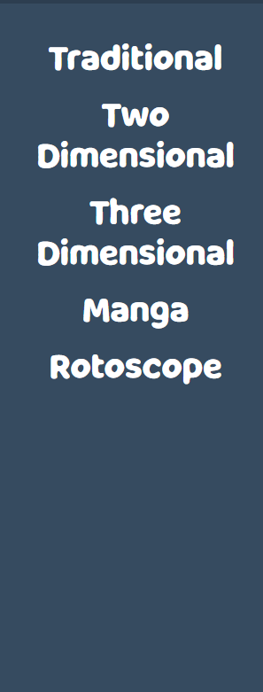
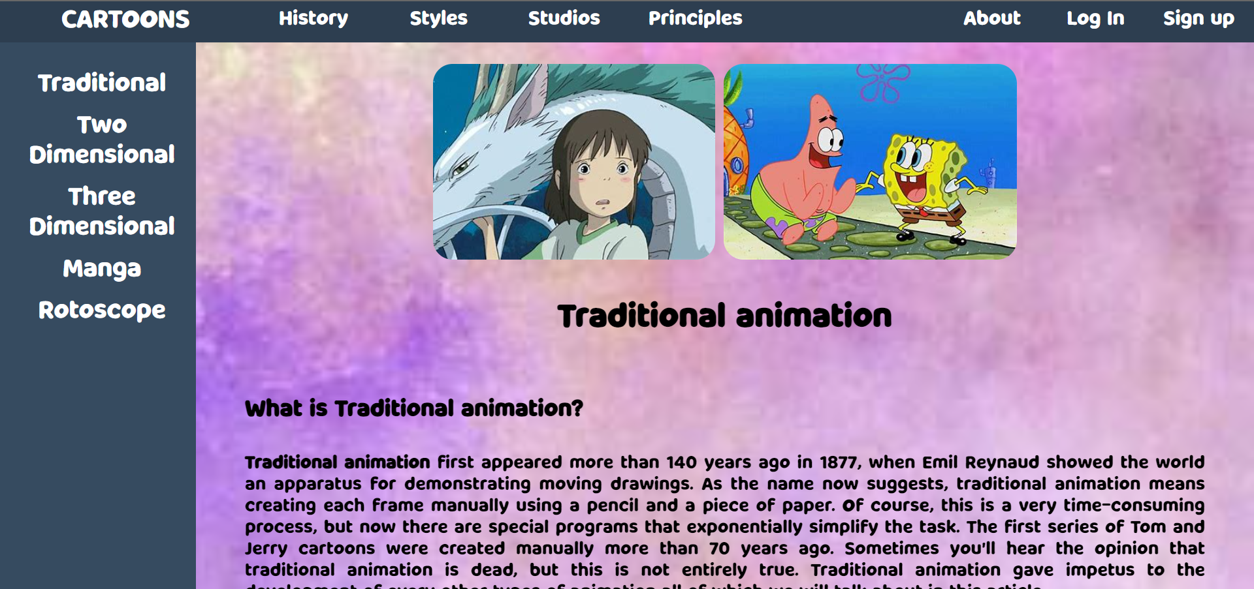
Sidebar part
5 animation styles
Furthermore detailed

Slide 17
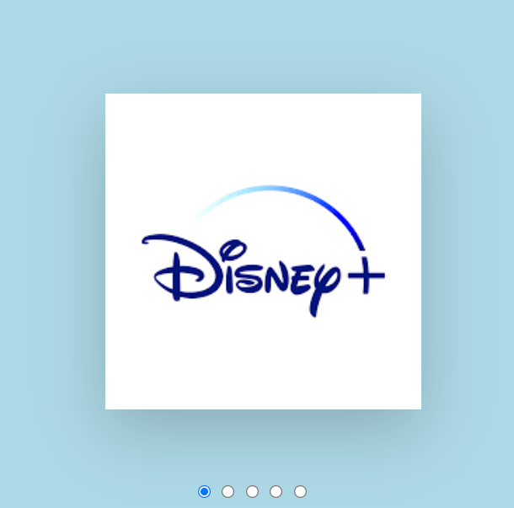
Nav-Cube
This is A Nav-Cube through which you can travel to any of the animation studios pages
The cube turns from side to side depending on which button is pressed.
Depending on the side of the cube the user clicks the representing webpage will be shown

Slide 18
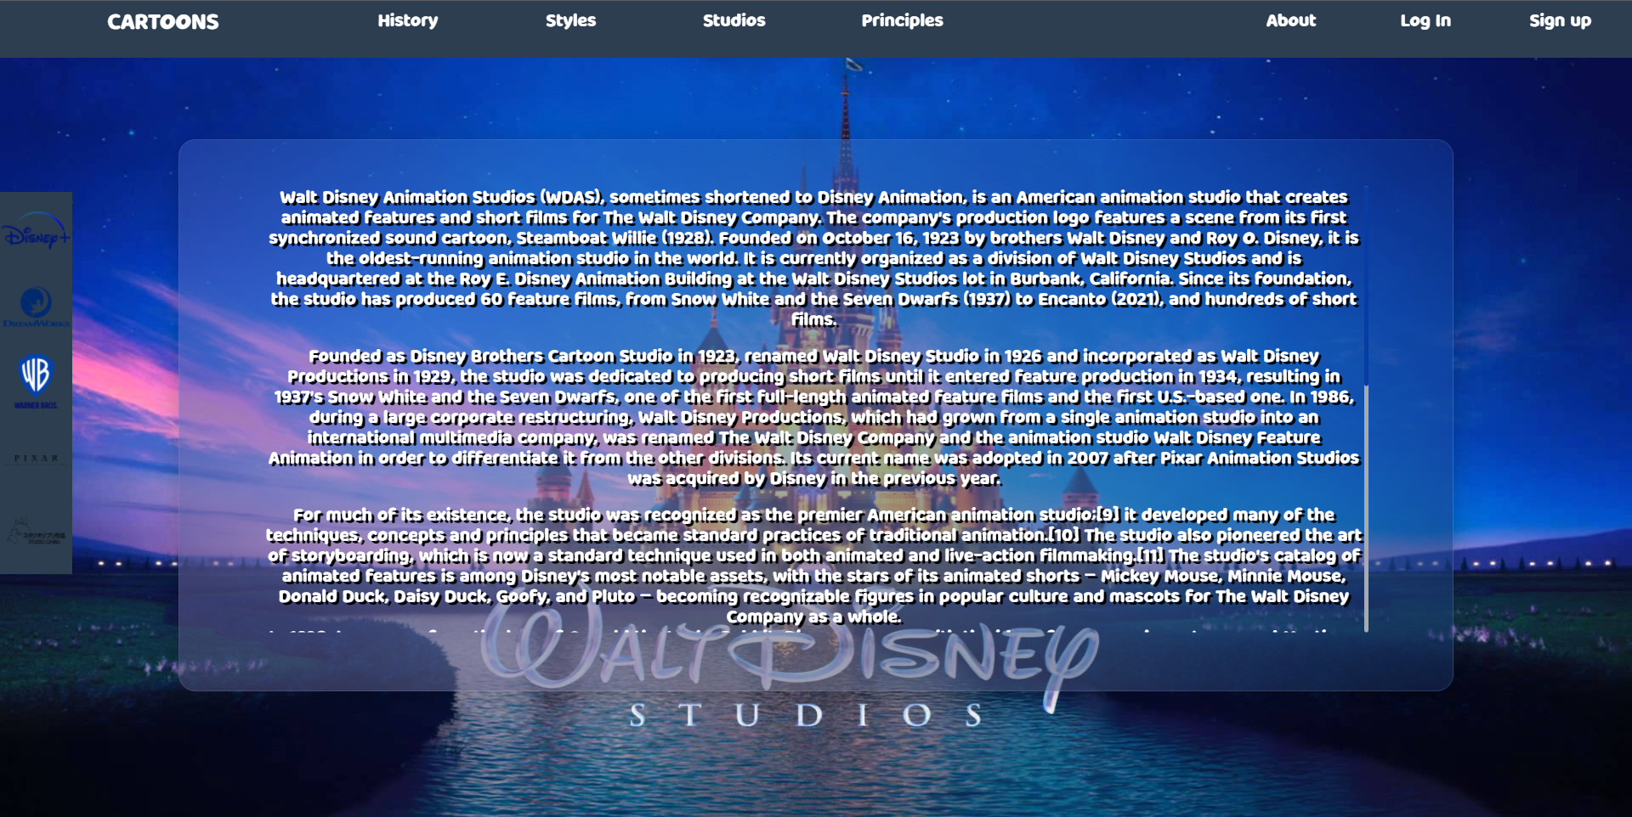
Studio Disney
Page is constructed from:
Background image
Sidebar
Content
Custom Scrollbar
Glass Container

Slide 19
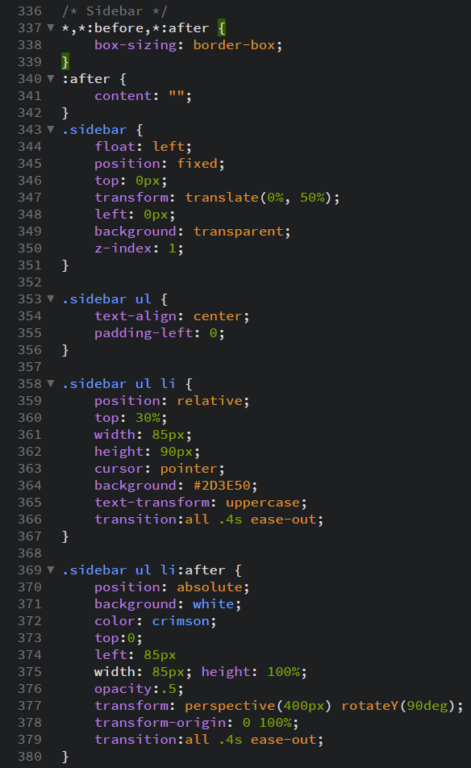
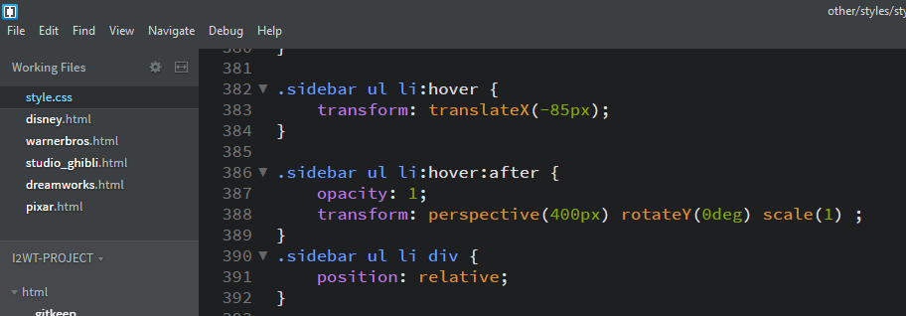
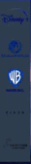
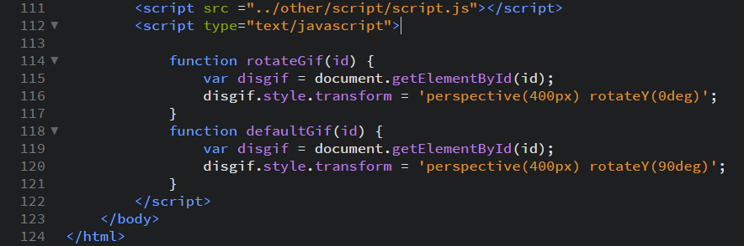
Sidebar
Navigate through pages
Images & GIFs
Rotation Animation

Slide 20
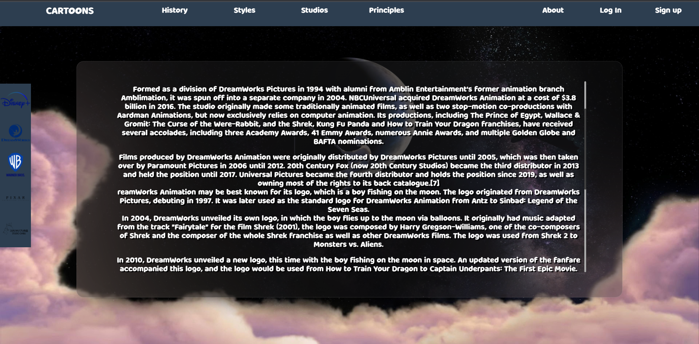
DreamWorks

Slide 21
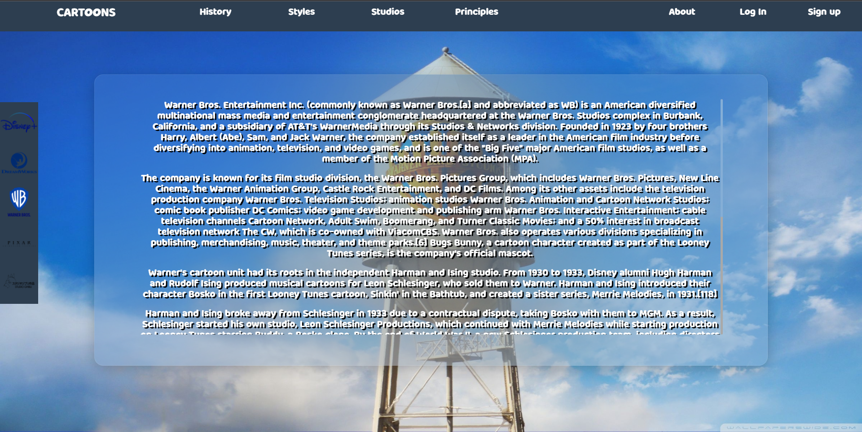
WarnerBros

Slide 22
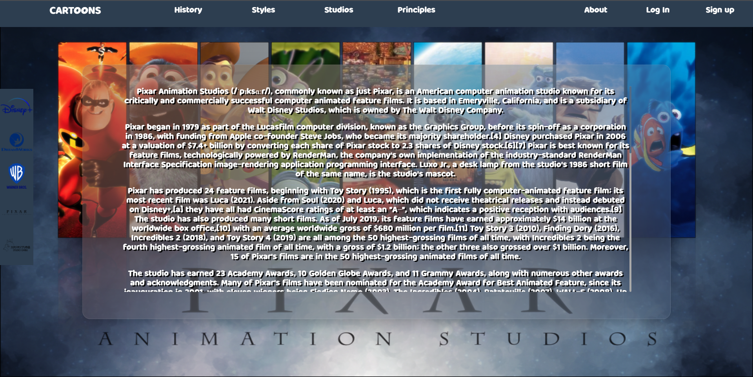
Pixar

Slide 23
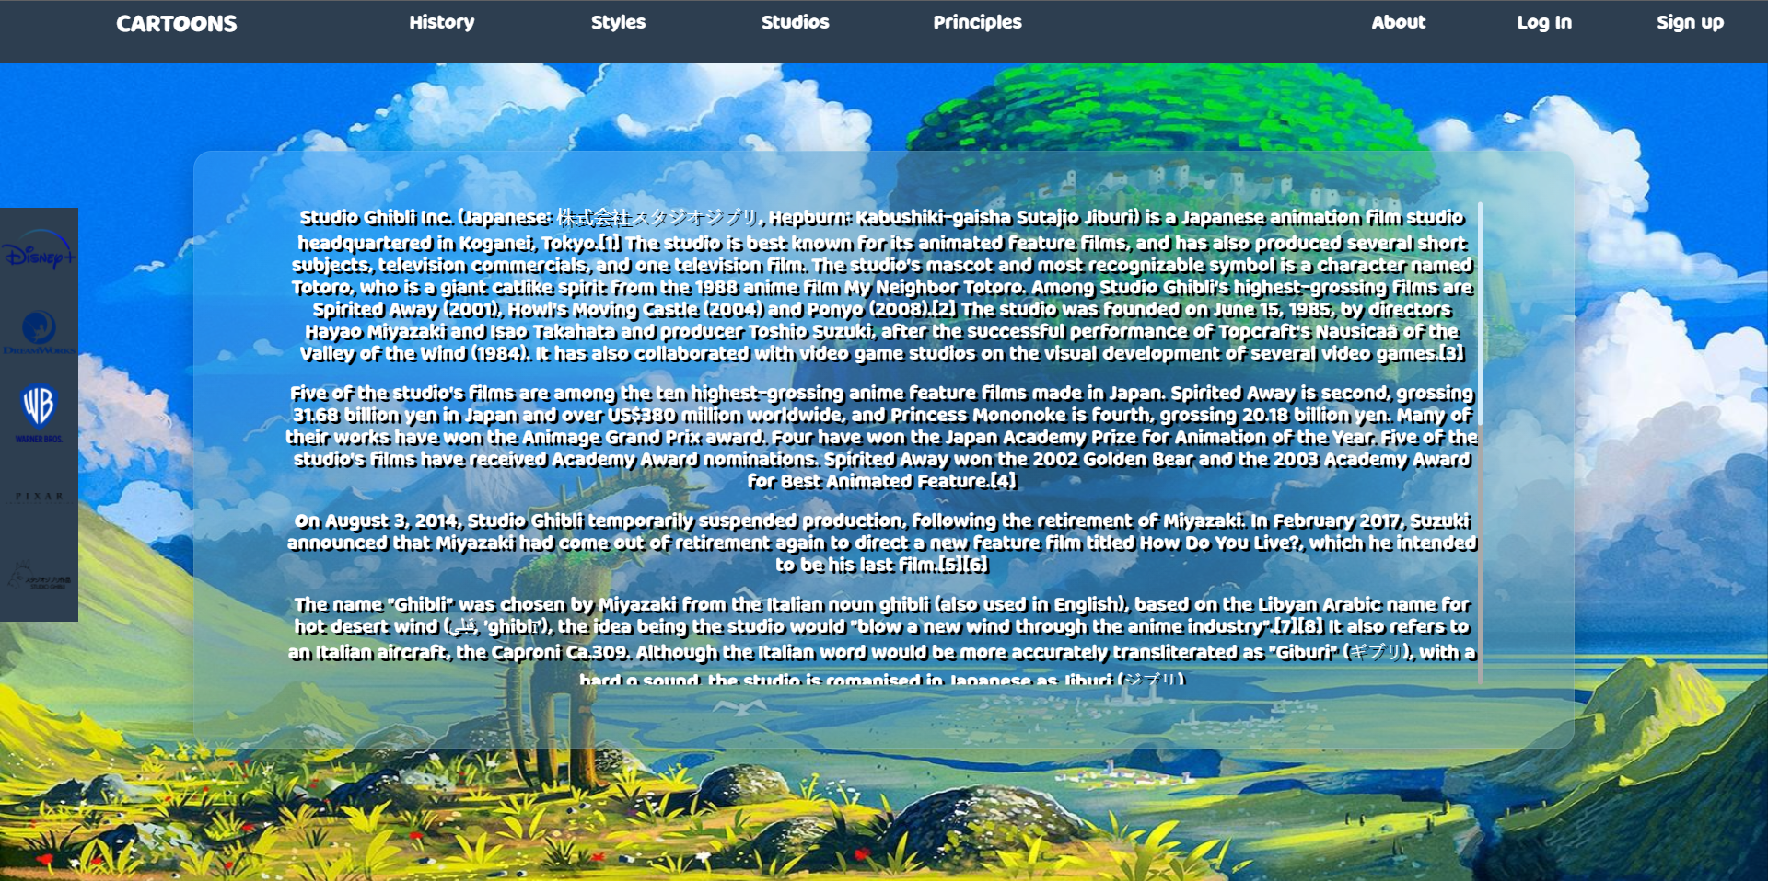
Studio Ghibli

Slide 24
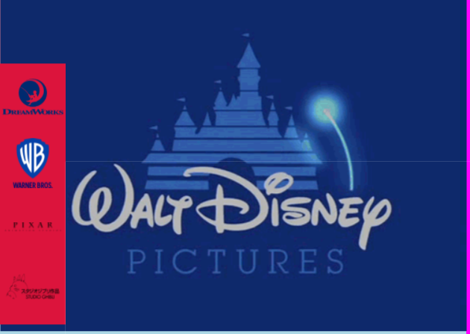
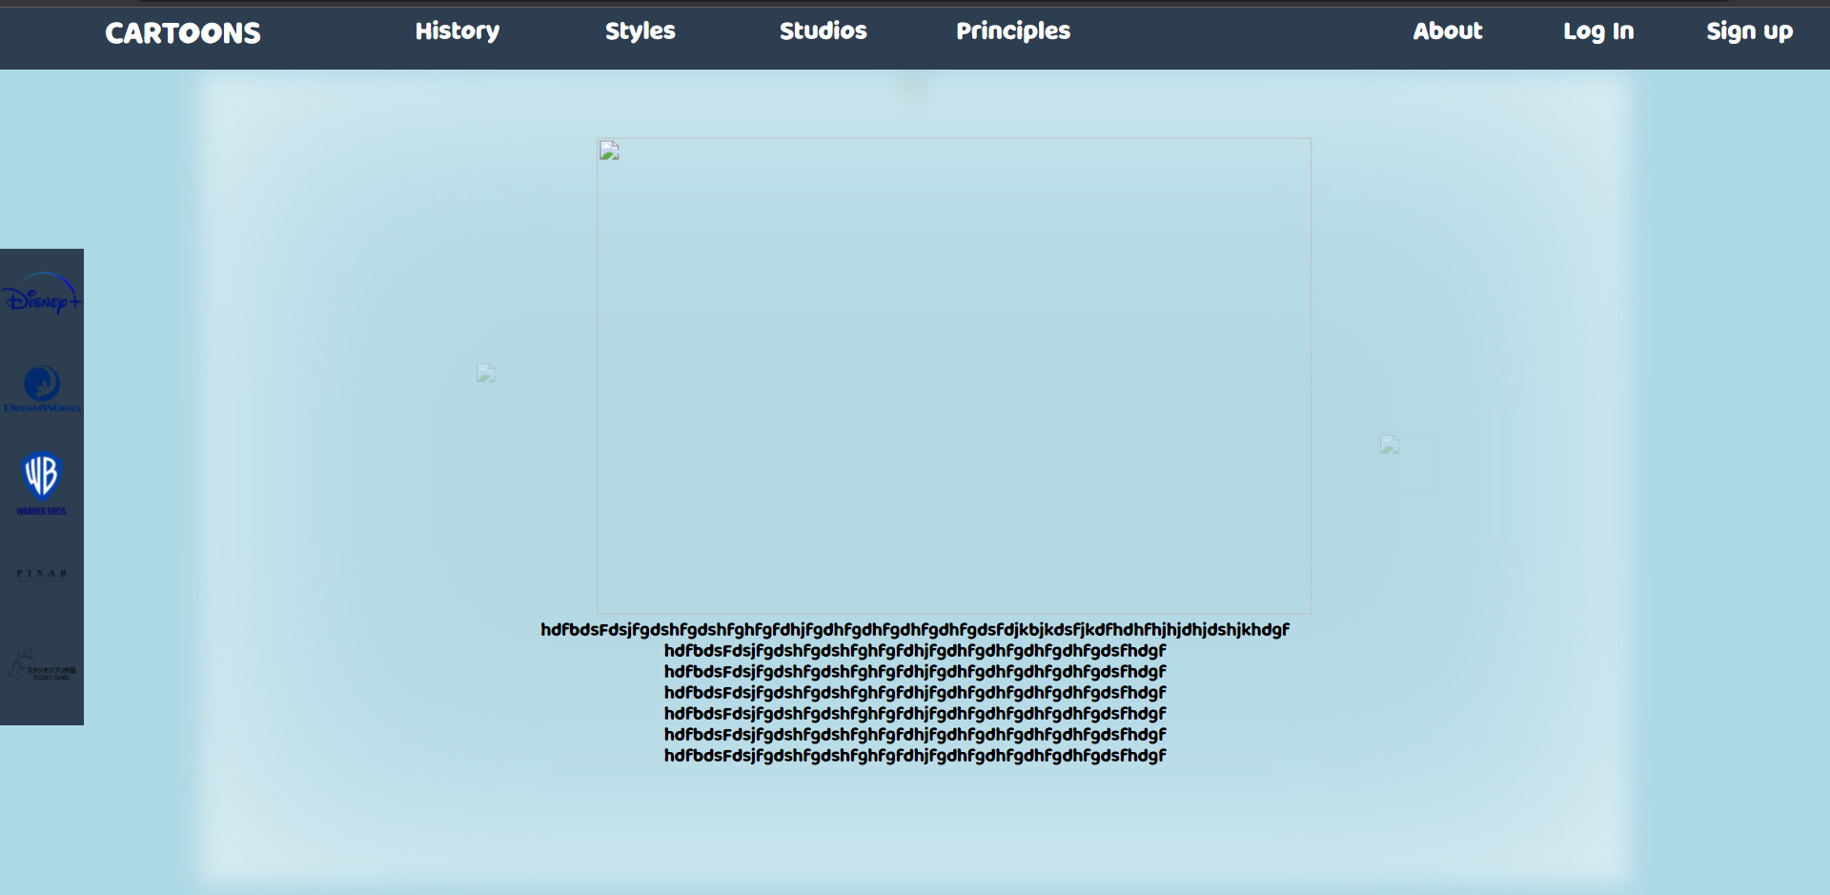
Failures
Perfection
Sidebar gif issue

Slide 25

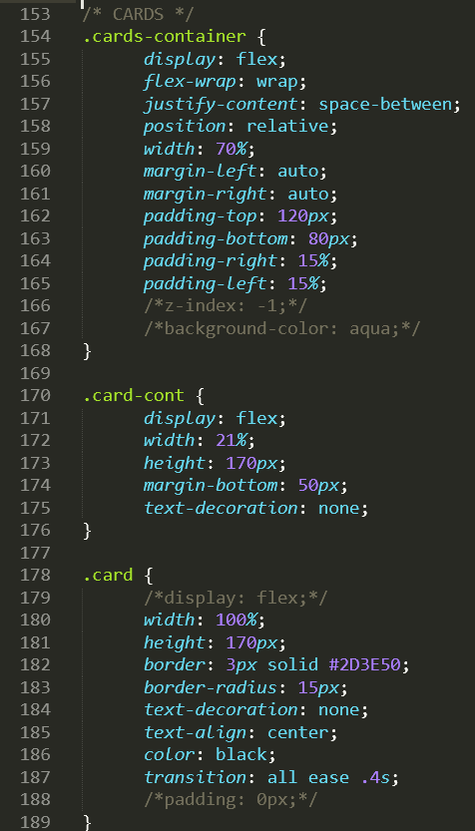
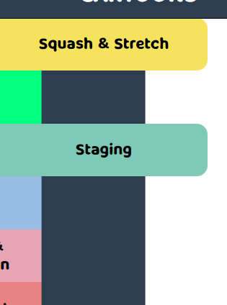
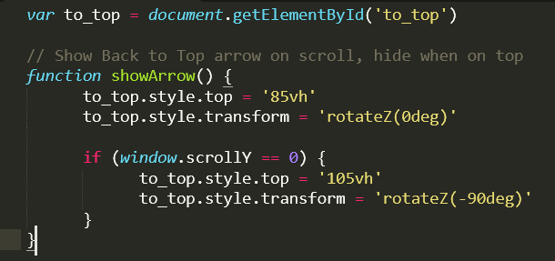
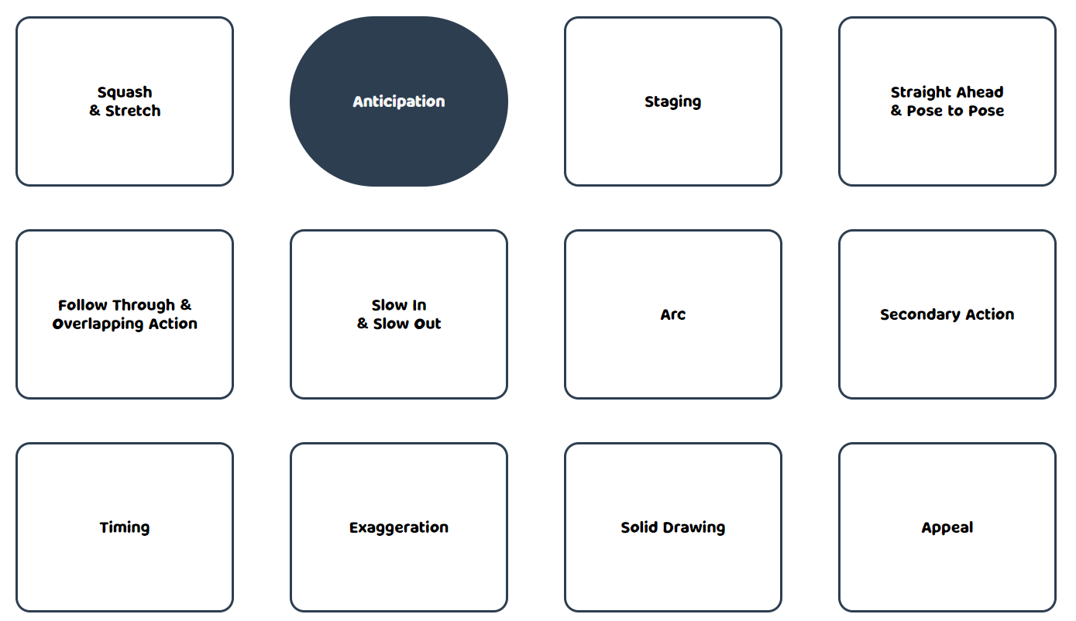
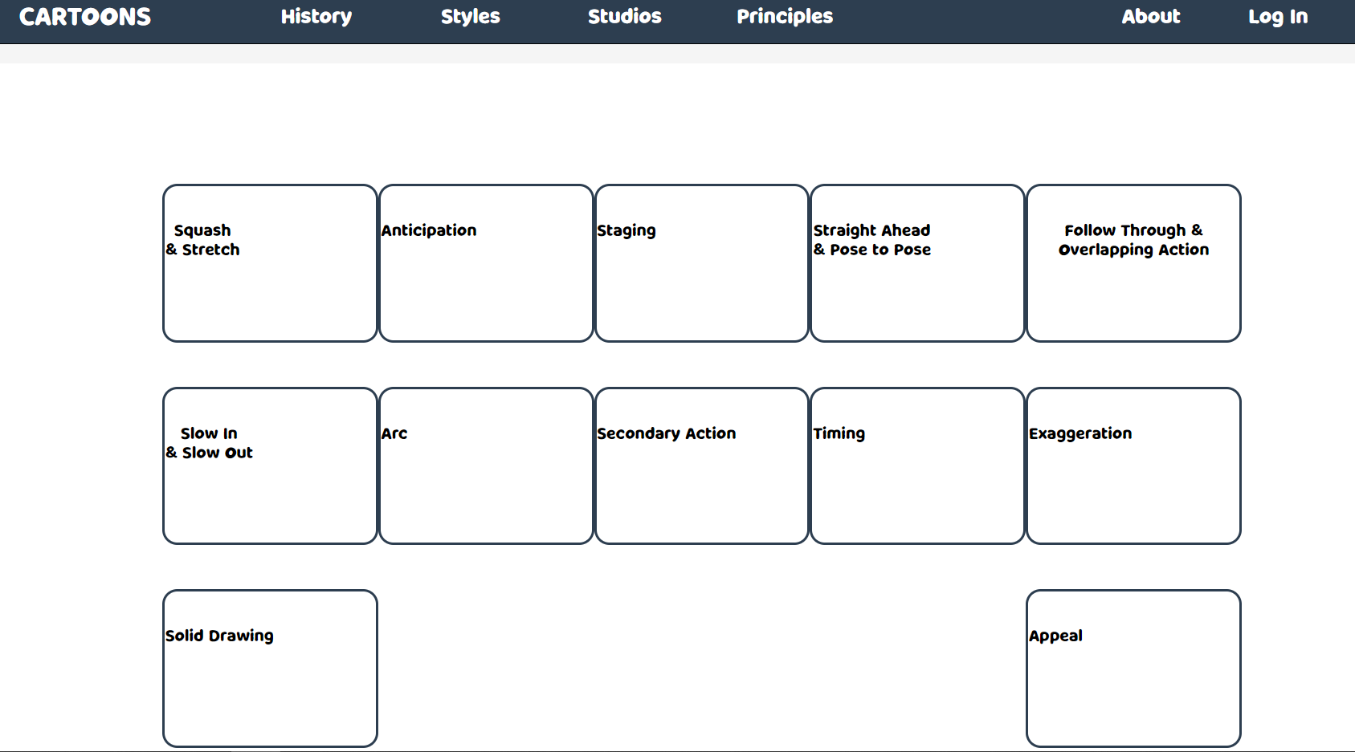
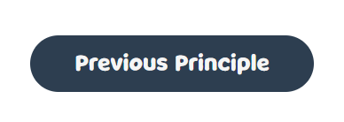
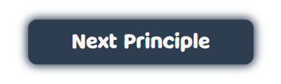
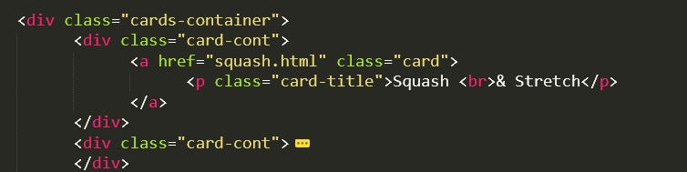
Principles
Cards
Navigating
To Top

Slide 26
THANKS!
Any questions?

